Slide 1
RIDE SHARE ANALYTICS
BY
Ritanjali Jena
Sowmya Ravichandran

Slide 2
About Uber
Uber is an American technology company operating in over 900 metropolitan areas worldwide
Uber is a ridesharing application that connects riders with drivers who have a contract with Uber. This implies that it doesn’t own a car, it just acts as a middleman between the customer and the car drivers
The application is known for its simplicity, open the application, set the pickup location, request a car, get dropped to the destination and make the payment
Uber believes in connecting people all over the world and strives to provide excellent customer service

Slide 3
Why Uber ?
The purpose of choosing Uber database is to dig deeper into learning how it manages to keep track of its massive database of drivers and riders and the data generated from each trip
It can serve as a blueprint for lot of other industries which function on the principle of renting instead of ownership
This business model is the future, and it will be intriguing to learn about the data that Uber needs to store in their database so that it is used in meaningful ways to best serve the people associated with the enterprise

Slide 4
How does Uber work ?
Uber has several users which are either customers or drivers
The customers select the desired location, the cab type and book the trip that are available
Upon completion of trips, the customer makes the payment out of which part of the payment goes to the Uber enterprise and the other part goes to the driver in that trip
Customers can book a trip or cancel a trip and if a booking is cancelled then the payment is refunded if it is charged

Slide 5
Business Rules : As a User
User makes an account on the Uber Website
The User can be a Customer to book the rides or wants to become the Driver to work with Uber
One User can either be a Customer, Driver or both Customer and a Driver
The Customer can make any number of bookings under his/her account
The person can register multiple drivers under his/her Uber Fleet Account under 1 Car. The only restriction is that he/she can use only one driver at a time as he/she need to assign the car to that one. And once car is assigned to one at one point of time than it cannot be assigned to anyone
Example: The person can add 2 drivers under his/her 1 car and let them drive one by one. One in day and the other in night
The user (both Customer and Driver) can give feedbacks/reviews to their respective trips.
The Customer can rate the Driver on his/her experience and the Driver can rate the Customer on his/her experience
The person can deactivate or activate his/her account any number of times

Slide 6
Business Rules : As an Enterprise
The Uber receive feedbacks from their customers and drivers. The feedback can be regarding the services, the website or the enterprise
The Uber can view all the statistics such as the total number of riders, total number of drivers, total number of cabs, total number of cabs in each locations, customer who has the highest number of trips, drivers who has the maximum number of trips, drivers who has received good ratings and so on
Uber maintains a backup of all the data that it has in its database, be it regarding the person information, the booking information or the payment information
Different employees of Uber will have different levels of access to the database

Slide 7
Business Rules : As an Enterprise
If a person is a driver and wants to deactivate his/her account, then the Uber should automatically delete the driver’s details so that no one can review the trips whose drivers does not exist
If a booking is made, then the payment table should automatically be populated, and the earnings of the Enterprise and the driver should be segregated
If the booking is cancelled by the customer, the payment made by the customer should be refunded immediately
If a trip has been booked by the customer for a cab, then other customer should not be able to book the same cab until the trip finished if its not an Uber pool

Slide 8
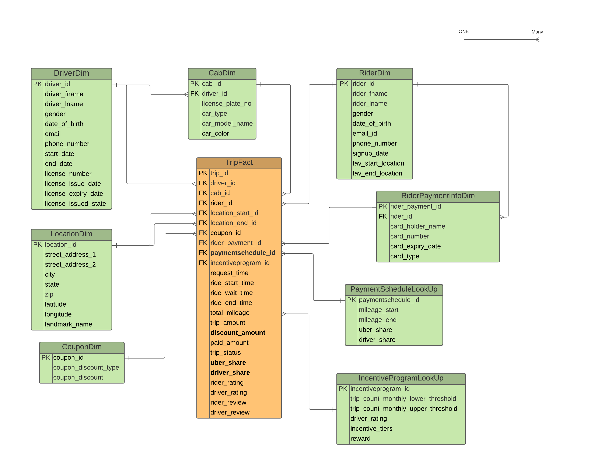
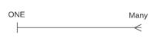
Logical Data Model

Slide 9
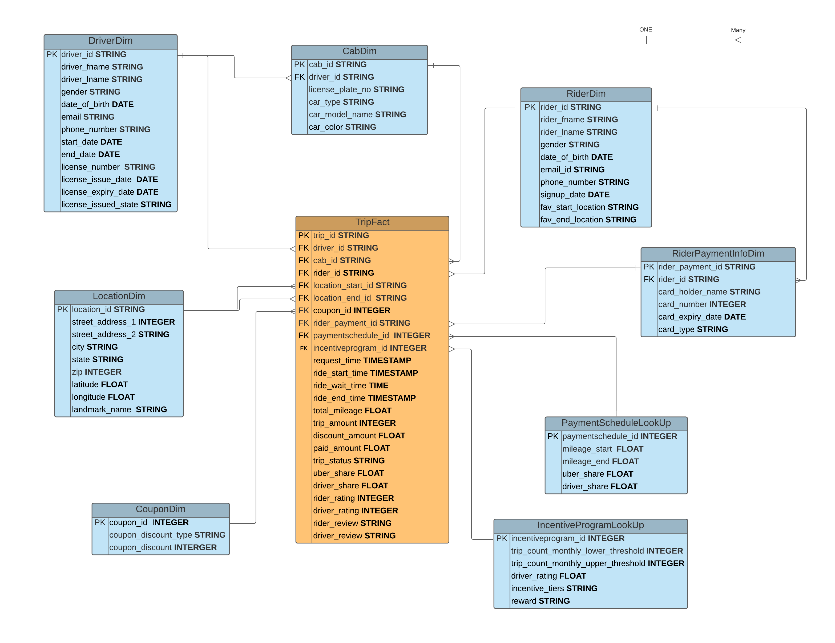
Physical Data Model

Slide 10
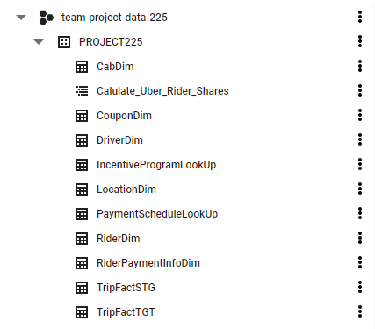
List of Tables
All the dimension tables were created using Create statement(s) and the data was inserted using insert statement(s)

Slide 11
STAGING LOAD
INSERT INTO PROJECT225. TripFactSTG
(trip_id, driver_id, cab_id, rider_id, location_start_id,
location_end_id, coupon_id, rider_payment_id, request_time,
ride_start_time, ride_wait_time, ride_end_time, total_mileage, trip_amount
)
SELECT trip_id, driver_id, cab_id, rider_id, location_start_id,
location_end_id, coupon_id, rider_payment_id, request_time,
ride_start_time, ride_wait_time, ride_end_time, total_mileage, trip_amount
FROM PROJECT225.tripfactstg

Slide 12
ETL PROCESS
CREATE OR REPLACE PROCEDURE PROJECT225.SP_Calulate_Uber_Rider_Shares()
BEGIN
TRUNCATE TABLE PROJECT225.TriFactTGT;
INSERT INTO PROJECT225. TripFactTGT
(SELECT TFS.trip_id, TFS.driver_id, TFS.cab_id, TFS.rider_id, TFS.location_start_id,
TFS.location_end_id, TFS.coupon_id, TFS.rider_payment_id, PSL.paymentschedule_id,
TFS.request_time, TFS.ride_start_time, TFS.ride_wait_time, TFS.ride_end_time,
TFS.total_mileage, TFS.trip_amount, TFS.discount_amount, TFS.paid_amount, TFS.trip_status,
(PSL.uber_share * TFS.paid_amount)/100 AS uber_share,
(PSL.driver_share * TFS.paid_amount)/100 AS driver_share,
TFS.rider_rating,TFS.driver_rating,TFS.rider_review,TFS.driver_review
FROM `team-project-data-225.PROJECT225.TripFactSTG` AS TFS
CROSS JOIN `team-project-data-225.PROJECT225.PaymentScheduleLookUp` AS PSL
WHERE COALESCE(TFS.total_mileage,0) BETWEEN PSL.mileage_start AND PSL.mileage_end
);
END;
CALL PROJECT225.SP_Calulate_Uber_Rider_Shares()

Slide 13
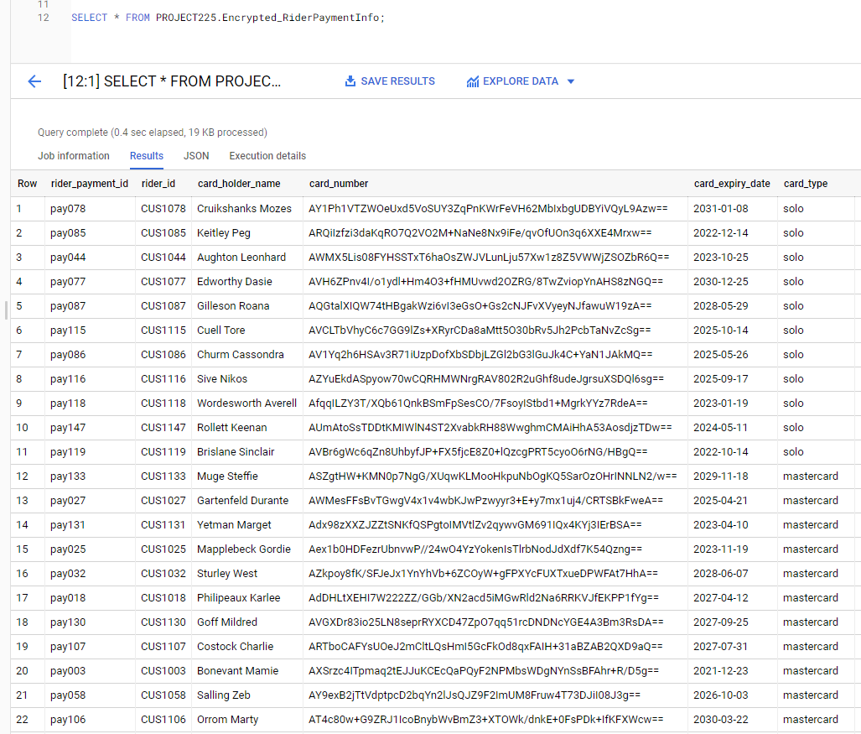
Scenario 1
Ensure that the customer data (specifically Personal Information Identifier) has been encrypted, from security standpoint

Slide 14
Scenario 2
Find out if the same person is both customer and driver, So, the person can get employee benefits when using the service.
Query :
SELECT
driver_id AS Customer,
first_name ,
last_name ,
gender,
email,
phone_number
FROM
PROJECT225.DriverDim AS DD
WHERE driver_id IN ( SELECT rider_id
FROM PROJECT225.RiderDim AS RD
WHERE rider_id=driver_id)

Slide 15
Output

Slide 16
Scenario 3
Find peak hours
Query :
CREATE OR REPLACE VIEW PROJECT225.View_PeakHours AS(
SELECT * FROM (SELECT request_time,Count(*) AS number_of_bookings
FROM PROJECT225.TripFactTGT
GROUP BY request_time order by request_time)
WHERE number_of_bookings > 40
)
SELECT * FROM PROJECT225.View_PeakHours

Slide 17
Output

Slide 18
Peak Hours

Slide 19
Scenario 4
List the count of drivers by their ratings
Query :
CREATE OR REPLACE FUNCTION PROJECT225.Function_DriverRating (
r1 int64,r2 int64
)
Returns int64
AS
((
SELECT COUNT(driver_id) FROM (SELECT driver_id FROM PROJECT225.TripFactTGT
WHERE driver_rating between r1 and r2) ));
SELECT STRUCT(PROJECT225.Function_DriverRating(4,5) AS Good,PROJECT225.Function_DriverRating(3,4) AS Average,PROJECT225.Function_DriverRating(1,3) AS Poor) AS driver_rating

Slide 20
Output :

Slide 21
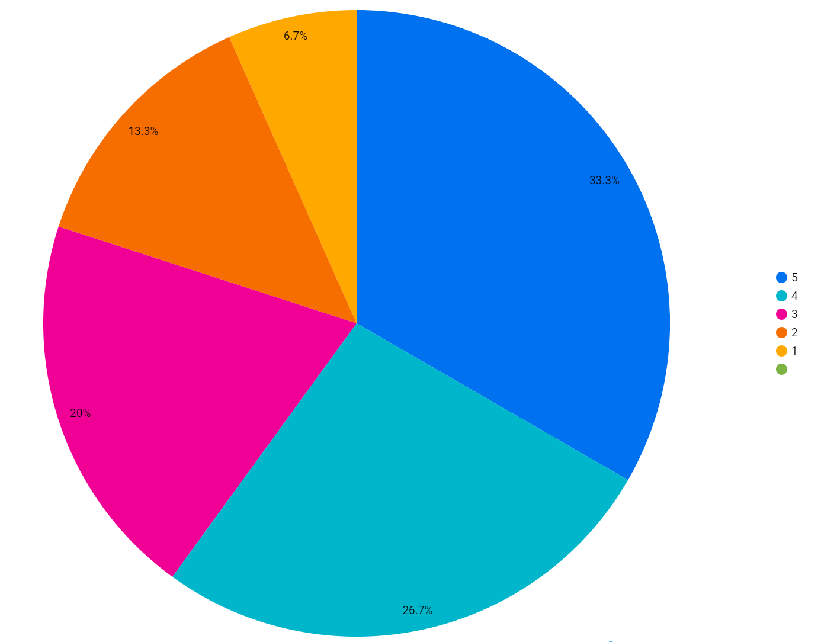
Percentage of drivers by ratings :

Slide 22
Scenario 5
Find all the drivers who have good reviews, and qualify for the incentive program
Query :
CREATE OR REPLACE VIEW PROJECT225.View_IncentiveDriverRating AS(
SELECT driver_rating,
ARRAY_AGG(STRUCT(TripFactTGT.driver_id AS id, CONCAT(first_name,' ',last_name) AS fullname)) AS driver
FROM PROJECT225.TripFactTGT
JOIN PROJECT225.DriverDim
ON DriverDim.driver_id = TripFactTGT.driver_id
WHERE driver_rating >= 4
GROUP BY driver_rating);
SELECT
DISTINCT(id), fullname, driver_rating
FROM PROJECT225.View_IncentiveDriverRating,
UNNEST(driver)
ORDER BY driver_rating DESC;

Slide 23
Output :

Slide 24
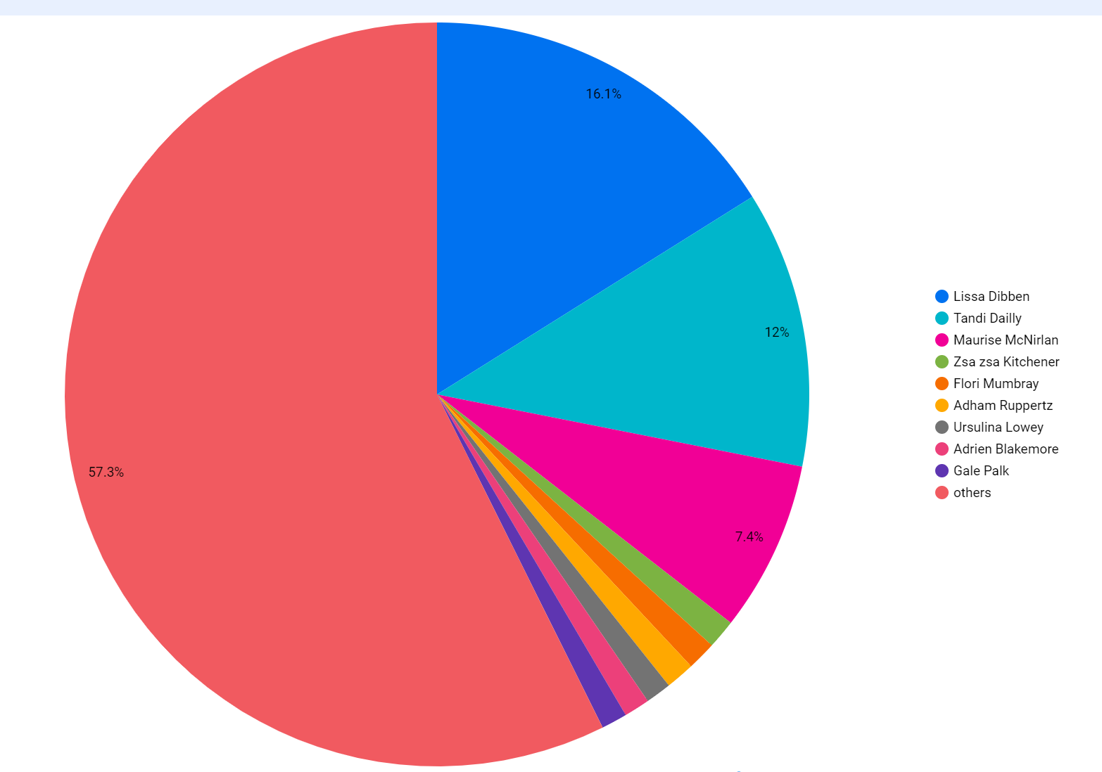
Find all the drivers who have good rating

Slide 25
Scenario 6
List all the riders who have not given any reviews, so the application can pop up a gentle reminder to request a review
Query :
SELECT T.rider_id,
CONCAT(first_name," ", last_name) AS customer_name,
T.driver_review AS trip_review
FROM PROJECT225.TripFactTGT T
JOIN PROJECT225.RiderDim R
ON T.rider_id = R.rider_id
WHERE driver_review IS NULL AND trip_status = 'completed'

Slide 26
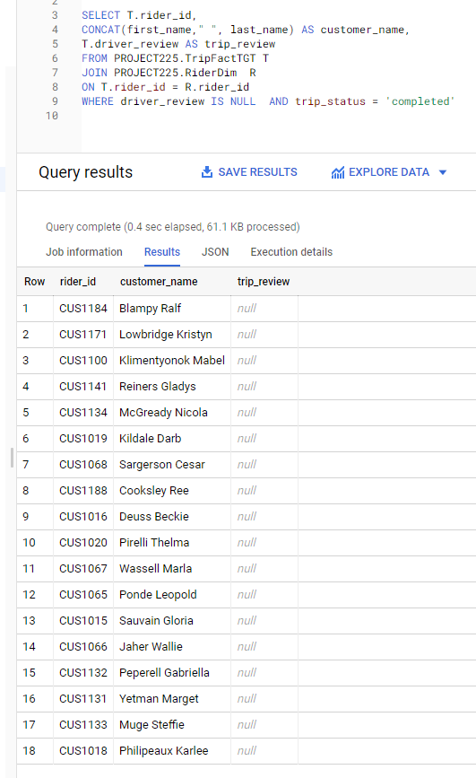
Output

Slide 27
Scenario 7
Find the top 20 riders who have the highest number of bookings, to reward the rider with quarterly flash promotions
Query :
CREATE OR REPLACE VIEW PROJECT225.View_Max_Trips_Customer
AS
SELECT R.rider_id, R.first_name, R.last_name,
COUNT(*) AS number_of_trips
FROM PROJECT225.TripFactSTG T
INNER JOIN PROJECT225.RiderDim R
ON T.rider_id = R.rider_id
GROUP BY rider_id,first_name, last_name
ORDER BY number_of_trips DESC
SELECT * FROM PROJECT225.View_Max_Trips_Customer
LIMIT 20

Slide 28
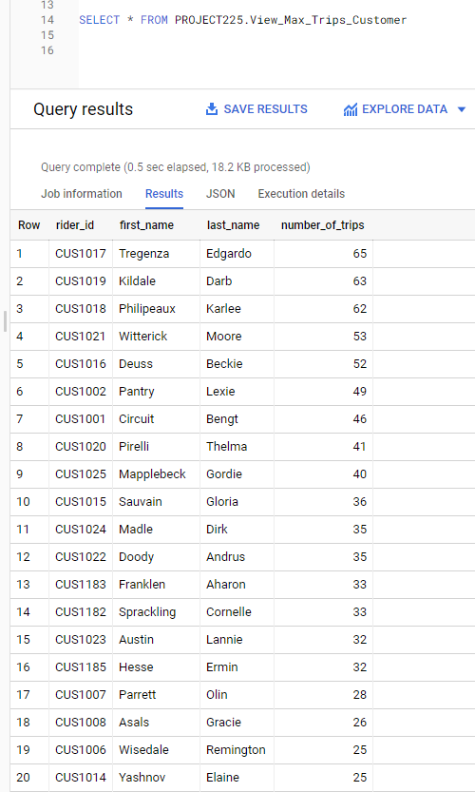
Output

Slide 29
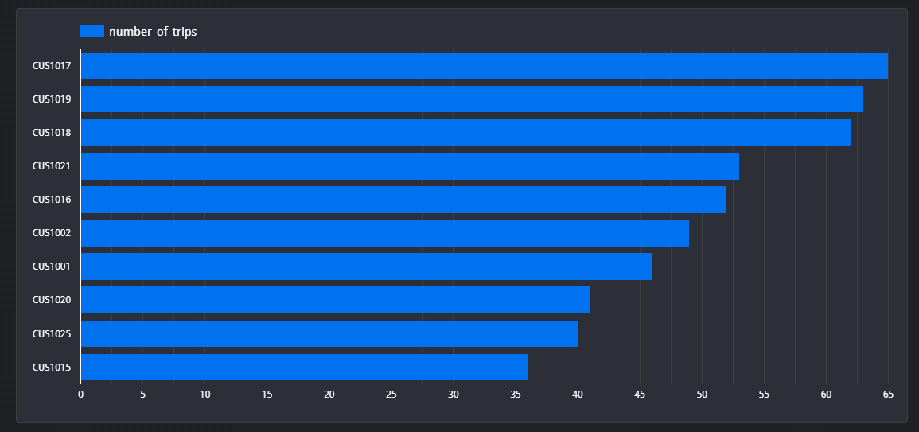
Top 10 customers with highest trip counts

Slide 30
Scenario 8
Find out all the positive feedbacks received by drivers
Query:
CREATE OR REPLACE VIEW PROJECT225.View_Positive_Feedback
AS
SELECT
trip_id,
DriverDim.driver_id,
CONCAT(first_name, " ", last_name) AS driver_name,
driver_review
FROM PROJECT225.TripFactTGT
JOIN PROJECT225.DriverDim
ON TripFactTGT.driver_id = DriverDim.driver_id
WHERE driver_review LIKE '%good%' OR driver_review LIKE '%best%' OR driver_review LIKE 'friendly%' OR driver_review LIKE 'polite%'
SELECT * FROM PROJECT225.View_Positive_Feedback

Slide 31
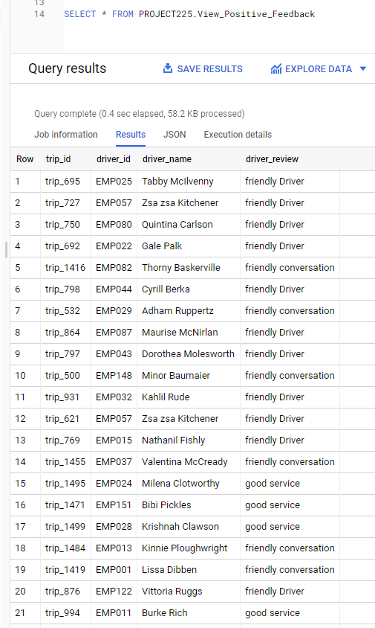
Output

Slide 32
Scenario 9
Find out all the negative feedbacks received by drivers
Query :
CREATE OR REPLACE VIEW PROJECT225.View_Negative_Feedback
AS
SELECT
trip_id,
DriverDim.driver_id,
CONCAT(first_name, " ", last_name) AS driver_name,
driver_review
FROM PROJECT225.TripFactTGT
JOIN PROJECT225.DriverDim
ON TripFactTGT.driver_id = DriverDim.driver_id
WHERE driver_review LIKE '%bad%' OR driver_review LIKE '%worst%' OR driver_review LIKE 'unfriendly%' OR driver_review LIKE 'impolite%'; SELECT * FROM PROJECT225.View_Negative_Feedback

Slide 33
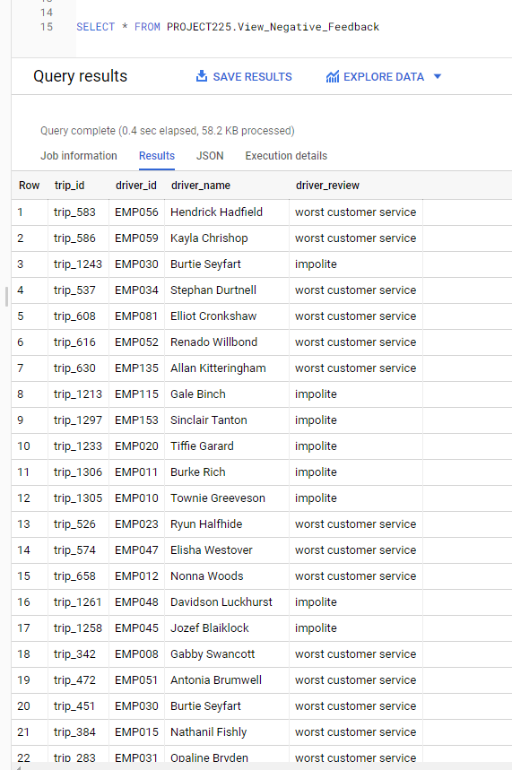
Output

Slide 34
Scenario 10
Find out the total earnings of the drivers till date
Query :
SELECT
TFT.driver_id
,DD.first_name
,DD.last_name
,ROUND(SUM(driver_share),2) AS total_earning
FROM `team-project-data-225.PROJECT225.TripFactTGT` TFT
INNER JOIN `team-project-data-225.PROJECT225.DriverDim` DD
ON TFT.driver_id = DD.driver_id
GROUP BY
TFT.driver_id
,DD.first_name
,DD.last_name

Slide 35
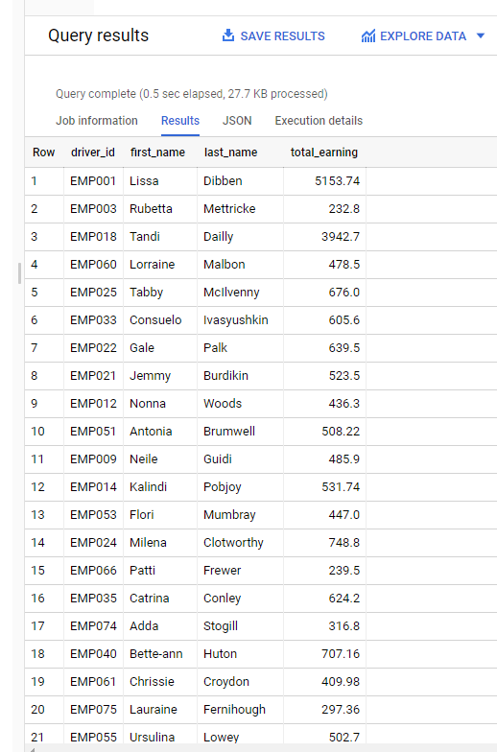
Output

Slide 36
Scenario 11
Find the total earnings of uber
Query :
SELECT
ROUND(SUM(uber_share),2) AS total_uber_earning
FROM `team-project-data-225.PROJECT225.TripFactTGT`

Slide 37
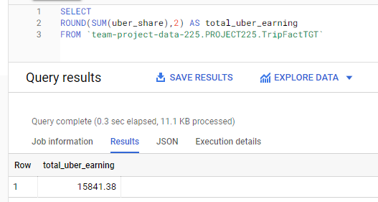
Output

Slide 38
Scenario 12
Find out the busiest city where the trip request were more
Query :
SELECT
LD.city,
COUNT(*) AS trip_request_count
FROM `team-project-data-225.PROJECT225.TripFactTGT` TFT
LEFT JOIN `team-project-data-225.PROJECT225.LocationDim` LD
ON TFT.location_start_id = LD.location_id
GROUP BY LD.city
ORDER BY trip_request_count DESC

Slide 39
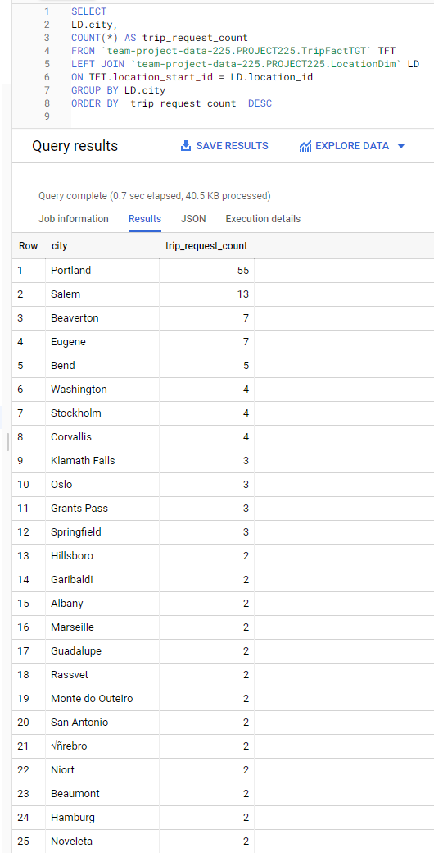
Output

Slide 40

Thankyou

